Slide 1

Online Payment Fraud Detection
By
Pritam Rajak
(B.Tech 3rd Year, Enrollment No.:12020002001056 )
Under the Supervision of
Sagarika Ghosh
Dept. of Computer Science & Engineering
University of Engineering & Management, Jaipur

Slide 2
Outlines
Introduction
Literature Review
Objectives
Proposed Model
Experimental Setup
Result Analysis
Conclusion & Future Scope
Reference
Acknowledgement

Slide 3
Introduction
To identify online payment fraud with machine learning, we need to train a machine learning model for classifying fraudulent and non-fraudulent payments. For this, we need a dataset containing information about online payment fraud, so that we can understand what type of transactions lead to fraud. For this task, I collected a dataset from Kaggle, which contains historical information about fraudulent transactions which can be used to detect fraud in online payments. Below are all the columns from the dataset I’m using here:
step: represents a unit of time where 1 step equals 1 hour
type: type of online transaction
amount: the amount of the transaction
nameOrig: customer starting the transaction
oldbalanceOrg: balance before the transaction
newbalanceOrig: balance after the transaction
nameDest: recipient of the transaction
oldbalanceDest: initial balance of recipient before the transaction
newbalanceDest: the new balance of recipient after the transaction
isFraud: fraud transaction

Slide 4
Objectives
I am trying to build a machine learning model to identify the online payment fraud Using Decision tree algorithm. and logistic regression.
My main objective is to extend this project to a web extension where whenever a fraud is detected according to my train model it will notify the user .

Slide 5
Proposed Model
For this project I am using Decision tree algorithm and logistic regression to build the model.
The basic info about Decision tree algo:
Decision Tree algorithm belongs to the family of supervised learning algorithms. Unlike other supervised learning algorithms, decision tree algorithm can be used for solving regression and classification problems too.
The basic info about logistic regression:
Logistic regression is a process of modeling the probability of a discrete outcome given an input variable. The most common logistic regression models a binary outcome; something that can take two values such as true/false, yes/no, and so on.
The general motive of using Decision Tree and logistic regression is to create a training model which can use to predict class or value of target variables by learning decision rules inferred from prior data(training data).

Slide 6
Experimental Set-up
1. First I have taken a dataset from kaggel.
2. Get info about the algo
3. Started the code importing the require libraries
4. Imported the dataset(naming it as data).
5. Check for null value
6.Counts the type value (Cash_out,payment,cash_in,transfer, debit).
7.Shown a pie chart of the data
8.Check for correlation(isFraud).
9.Then mapped it with the data[“type”] and data[“isFraud”] with Fraud or No fraud
10. Creadted tow array X for {type, amount,oldbalanceorg,newbalanceorg} and
Y for {isfraud}
11.Separated data for train and testing
12. Train the decision tree model and measure the score of accuracy .
13. Train the logistic regression model and measure the score of accuracy .
14. Write a menu driven code for checking it multiple times.
15. Predict is Fraud or No fraud with there given input.

Slide 7
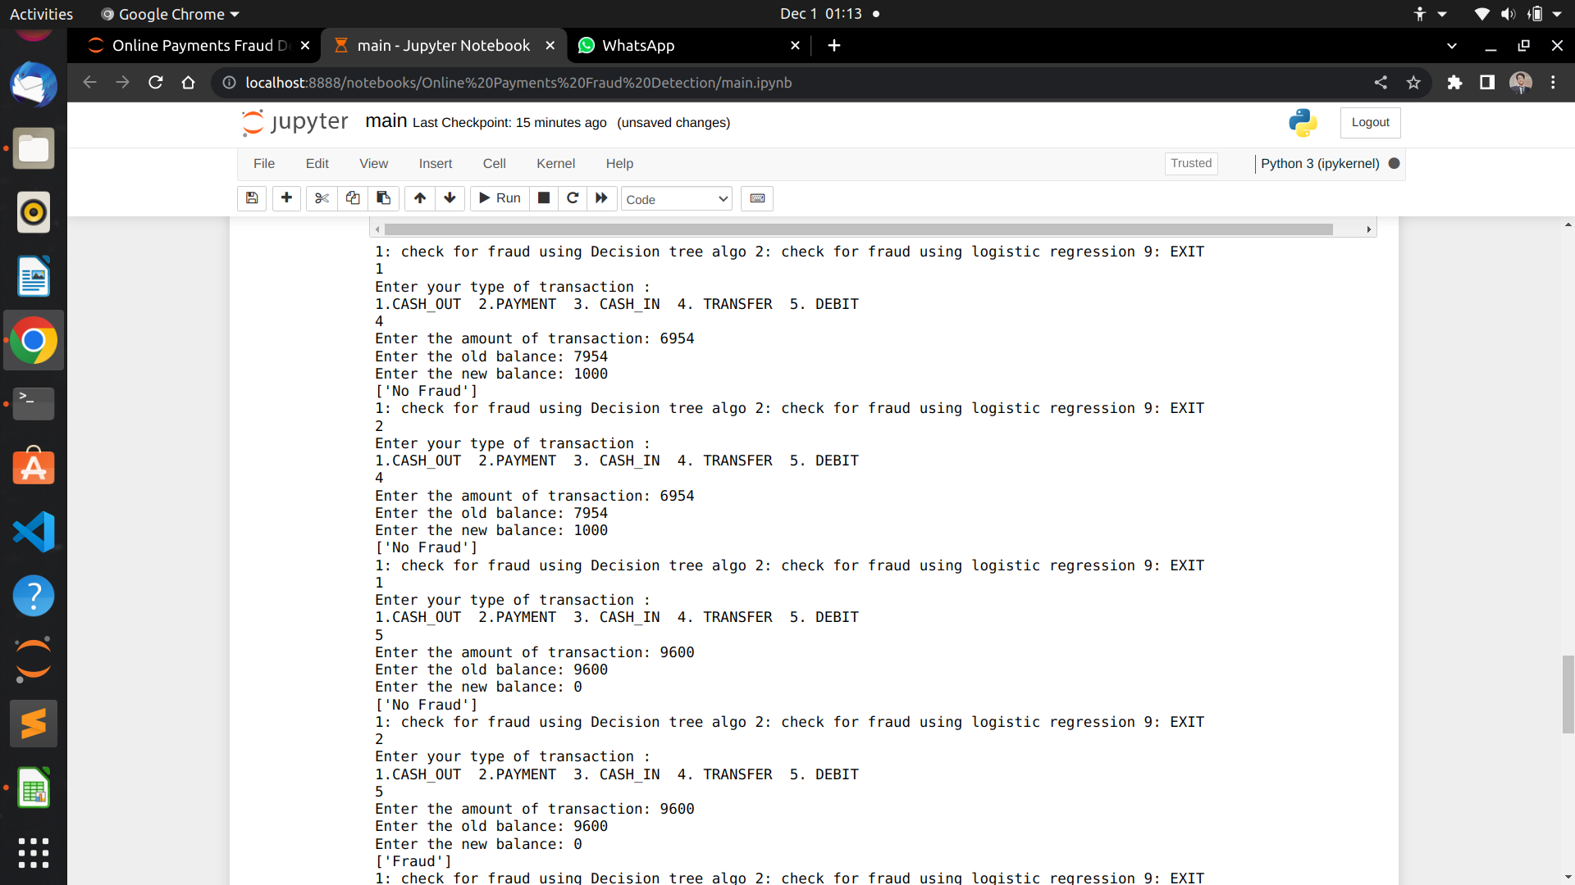
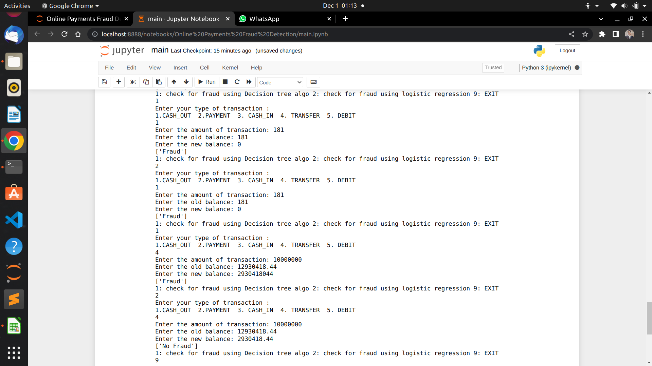
Result: Example

Slide 8
Result Analysis
We are getting output in both the algorithm but the estimate out we are getting from decision tree algorithm .
The accuracy of decision tree algorithm is 99% and providing the estimate output so we can say for this project the decision tree algorithm is best among this.

Slide 9
Limitation
The project has few limitation that :
1. It can use after the transaction has done
2. It is still not prepare to be used in web extension or application
3. more algorithm can be implemented.

Slide 10
Conclusions & Future Scope
I can conclude my project by saying that it is effectively accurate. It get the accuracy of 99% . Decision tree algorithm is performing much better as compare to logistic regression
The future scope of this project online payments fraud detection is :
1. to build a web extension of this project
2. to build a application of this project
So that the normal people does not be the victim of online payment fraud.

Slide 11
References
Credit card fraud detection:
https://dataaspirant.com/credit-card-fraud-detection-classification-algorithms-python/
Decision tree concept
https://youtu.be/coOTEc-0OGw
logistic regression
https://www.sciencedirect.com/topics/computer-science/logistic-regression

Slide 12
Acknowledgement
I would like to express my gratitude to my project guide prof. Sagarika Ghosh for guiding me through this project and I would also thank Kaggle for payment fraud dataset available for public use. I also sincerely thank the skillful developers of Sklearn, Pandas and Python for their ceaseless efforts in maintaining the libraries and packages.

Slide 13

Dept. of CSE, University of Engineering & Management Jaipur

